Slide 1
HOMELESSNESS DURING COVID-19 WEBINAR: Counties, Cautions, Cases and the CDC
Moderated by:
Christine Dietrick
City Attorney, San Luis Obispo

Slide 2
Outline
Pre-COVID state of the law – Boise v. Martin (9th Cir.; Cert. denied December 16, 2019)
Governor’s Orders and CDC Guidance related to homelessness post-COVID
Programs relating to homelessness and COVID 19
Overview of the most recent legal challenges to public entities arising out of the COVID related to homelessness

Slide 3
Pre-COVID Legal Baseline
Martin v. City of Boise (2019) – Criminal enforcement of public camping ordinances when there were no adequate alternatives for shelter violated the Eighth Amendment.
Plaintiff claimed the City of Boise's public camping ordinance violated the Eighth Amendment’s prohibition against cruel and unusual punishment. The City alleged it did not enforce the public camping ordinance when homeless shelters were full.
Court found the ordinance in violation of the Eighth Amendment because it criminalized involuntary and necessary human activity, such as sleeping, which unhoused individuals cannot avoid doing in public places, when accessible shelter alternatives are not available.
Homeless advocates have asserted this ruling entirely prohibits enforcement of anti-camping ordinances and that cities cannot clear or clean up encampments.
Holding is relatively narrow, but still renders relocation or removal of encampments impossible for many cities.

Slide 4
CDC Guidelines Regarding COVID-19
As revised May 10, 2020, CDC recommends that “homeless shelters should not close or exclude people who are having symptoms or test positive for COVID-19 without a plan for where these clients can safely access services and stay.”
“Community coalitions should identify additional temporary housing and shelter... (such as hotels/motels) that have individual rooms.”
Local authorities should ensure that public restroom facilities remain open, especially near areas with encampments housing over 10 people.
Local government should create overflow sites to reduce crowding, isolation sites, quarantine sites for people waiting to be tested, and protective housing for people at the highest risk of severe COVID-19

Slide 5
CDC Guidelines Regarding COVID-19
Encampments and Clean up:
“The balance of risks [between congregate housing and unsheltered outdoor living] should be considered for each individual experiencing unsheltered homelessness.”
CDC generally, recommends that encampments not be dispersed during COVID-19 to help prevent the dispersion of infected individuals throughout the community and disconnection from service providers, unless individual shelter is available.
If there are beds at shelters available, with appropriate distancing, that is still the best option.
CDC encourages those staying in encampments to set up their tents/sleeping quarters with at least 12 feet x 12 feet of space per individual.
Full CDC Guidance: https://www.cdc.gov/coronavirus/2019-ncov/community/homeless-shelters/unsheltered-homelessness.html#prevention.

Slide 6
Emergency Orders Regarding Homelessness
EXECUTIVE ORDER N-25-20 (March 12, 2020)
Allows the California Health and Human Services Agency and Office of Emergency Services to commandeer hotels, places of temporary residence, and medical facilities to be used for quarantining and treating individuals who have a high-risk exposure to COVID-19.
EXECUTIVE ORDER N-32-20 (March 18, 2020)
Suspended any restrictions on spending of Homeless Emergency Assistance Program (HEAP) and Homeless Housing and Assistance and Prevention Program (HHAP) that otherwise might have prevented spending for COVID 19 preparation and protections activities and shelter (e.g., one-time expenditure provisions).

Slide 7
Project Homekey Overview- County Contracts and Funding
Project Homekey (an transition of “Project Roomkey") was initiated by Governor Newsom to address the concern that COVID would overtake the homeless community; encourages cooperation between the State and Counties to identify and secure hotels, motels or self-contained trailers (non-congregate shelter) for vulnerable individuals experiencing homelessness to occupy during COVID-19.
Homekey is a $600 million grant; $550 million from the state's direct allocation of the federal Coronavirus Relief fund (CRF) and $50 million from the state General Fund.
Funds received through the CRF must be spent by December 30, 2020. Funds awarded from the general fund must be spent by June 30, 2022. Applications can be found below.
The Department will disburse funds to cover Homekey-critical expenditures that were incurred during the period of March 1, 2020 through December 30, 2020.
https://www.hcd.ca.gov/grants-funding/active-funding/homekey/docs/2020_HCD_HomeKey-NOFA_07-15-2020.pdf

Slide 8
Project Homekey -Con’d
CEQA does not apply to a project funded by Project HomeKey (HSC Section 50675.1.2) if the city, county, or city and county where the project is located submits an application on or before April 30, 2021 and follows the specified requirements (see second link page 3).
This exemption will be repealed on July 1, 2021.
Eligible Applicants are required to demonstrate a five-year commitment to provide operating funds for the proposed project. The first two years of operating funds may include an award from the $50 million in state General Fund
1. https://opr.ca.gov/docs/20200715-PHK_TA.pdf
2. https://www.hcd.ca.gov/grants-funding/active-funding/homekey/docs/2020_HCD_HomeKey-NOFA_07-15-2020.pdf

Slide 9
Recent Legal Challenges to Public Entities Regarding Homelessness
Bloom et al. v. City of San Diego (April 22, 2020) –vehicle camping
U.S. District Court, Southern District
City of Laguna Hills v. Elite Hospitality Inc.; County of Orange (April 20, 2020)
LA Alliance for Human Rights et. al v. City of Los Angeles et. al (March 10, 2020)
United States District Court, C.D. California. May 22, 2020Slip Copy2020 WL 2615741

Slide 10
LA Alliance for Human Rights et al v. City of Los Angeles et al.
The Court ordered an injunction that the defendants (city, county, and joint) must relocate roughly 3,100 individuals from underneath freeway underpasses, overpasses, and ramps.
Relies on Welfare & Institutions Code Section 17000 et seq. and substantive due process grounds (reckless disregard for those living near freeway areas that shocks the conscience) and eighth amendment grounds.

Slide 11
Bloom et al v. San Diego
In 2017, Bloom sued the city of San Diego over two ordinances that prohibited individuals living in their vehicles. One of these ordinances prohibited living in vehicles and the other prohibited overnight RV parking.
In 2018, the Court granted in part a preliminary injunction against enforcement of the vehicle habitation ordinance, but denied as to the RV parking;
In 2019, the City repealed the vehicle habitation ordinance, but later replaced it with a new ordinance;
In April 2020 the court allowed plaintiffs to amend their complaint to challenge the new ordinance and the plaintiffs sought a temporary restraining order preventing the enforcement of the two ordinances because of COVID-19.
Bloom alleges the city does not offer enough alternative living situations for individuals to not live in their cars and that the laws disproportionately impact disabled individuals in violation of disability protections.

Slide 12
City of Laguna v. Elite Hospitality Inc.; County of Orange
The City of Laguna Hills sued Elite Hospitality Inc. and Orange County on April 20, 2020, to prevent Project Roomkey from taking effect in the city.
The city claims that Project Roomkey is a public nuisance and endangers the lives of citizens within the city. Additionally, the city claims that the county made an agreement with Elite Hospitality before consulting with the city, thereby violating the portion of Project Roomkey that states “all of these local efforts should be closely coordinated with applicable local partners, including cities…”
The county successfully defended Project Roomkey utilzing Governor's executive order and broad emergency powers to oppose the the injunction.
Resource link: https://www.ci.laguna-hills.ca.us/DocumentCenter/View/5074/Brief-of-Governor-Gavin-Newsoms-Support-of-Orange-Countys-Opposition-to-Plaintiffs-Ex-Parte-App.

Slide 13
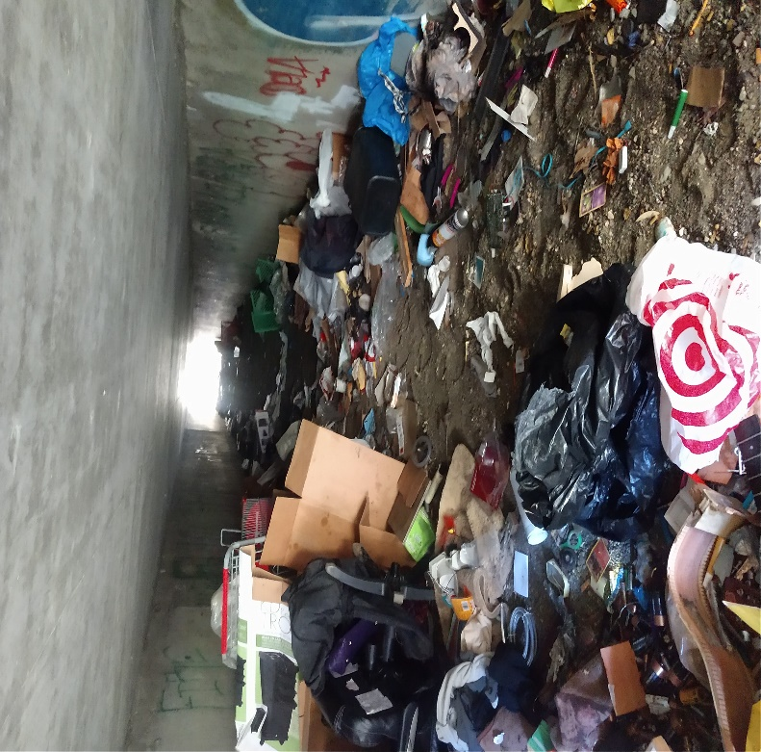
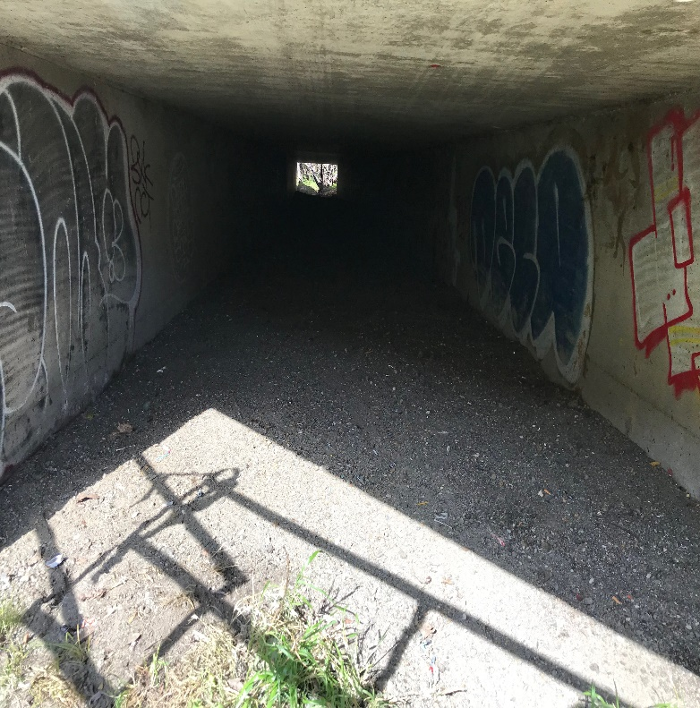
Recent Experience in SLO
Current litigation threat by California Rural Legal Assistance
Significant encampment cleanups; protocol to post notice in advance, offer services, storage of personal belongings, and shelter relocation to all occupants who can be contacted.

Slide 14
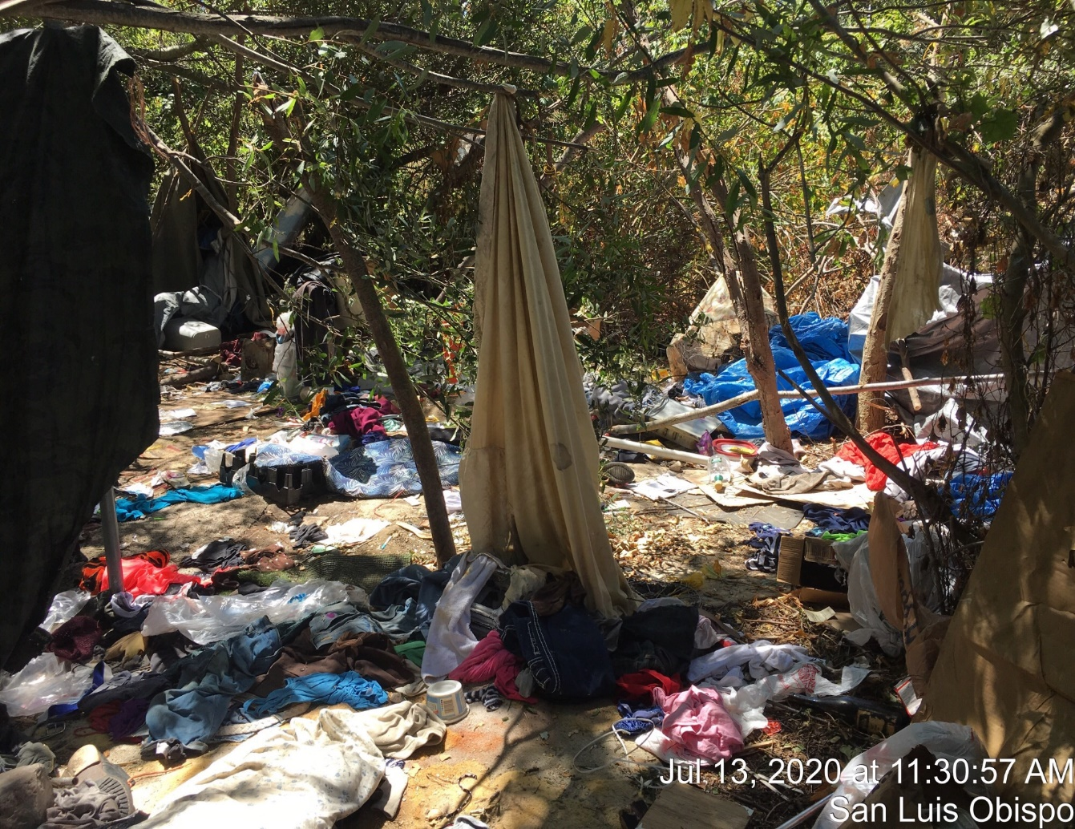
Recent Experience in SLO

Slide 15
Questions & Discussion

